Slide 2
MOBILE SENSORY DATA
ANALYSIS AND PREDICTION REPORT

Slide 3
Commonly related labels
label:OR_exercise
100% of relevant label of label:AT_THE_GYM were also indicated for label:OR_exercise
100% of relevant label of label:BICYCLING were also indicated for label:OR_exercise
100% of relevant label of label:FIX_running were also indicated for label:OR_exercise
label:OR_indoors
100% of relevant label of label:SLEEPING were also indicated for label:OR_indoors
100% of relevant label of label:BATHING_-_SHOWER were also indicated for label:OR_indoors
100% of relevant label of label:DRESSING were also indicated for label:OR_indoors
92.7% of relevant label of label:LYING_DOWN were also indicated for label:OR_indoors
100% of relevant label of label:IN_CLASS were also indicated for label:OR_indoors
88.9% of relevant label of label:GROOMING were also indicated for label:OR_indoors
77% of relevant label of label:LYING_DOWN were also indicated for label:SLEEPING
74.74% of relevant label of label:LYING_DOWN were also indicated for label:LOC_home

Slide 4
Project analysis slide 4
Label source with the highest count of examples
Label Source | Percentage(%)
2 | 69.71
-1 | 18.29
1 | 6.17
6 | 2.89
4 | 1.85
5 | 0.16
0 | 0.04

Slide 5

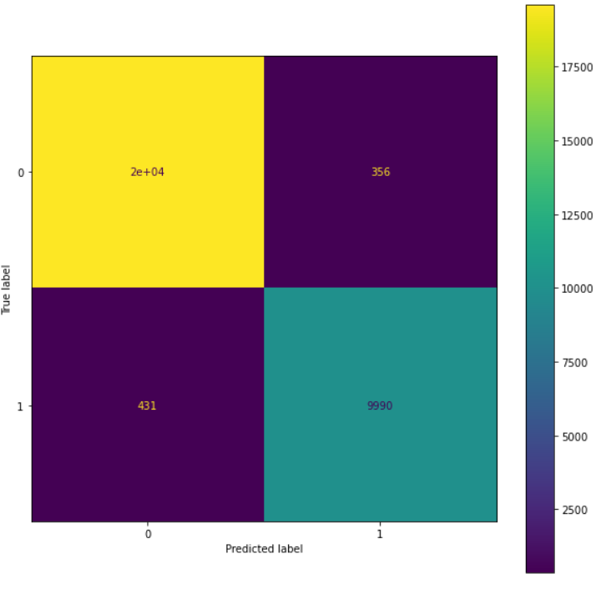
Project analysis slide 4
Predicting label:LYING_DOWN
Confusion Matrix
Accuracy – 97%
Precision – 97%
Recall – 97%
F1 Score – 97%

Slide 6
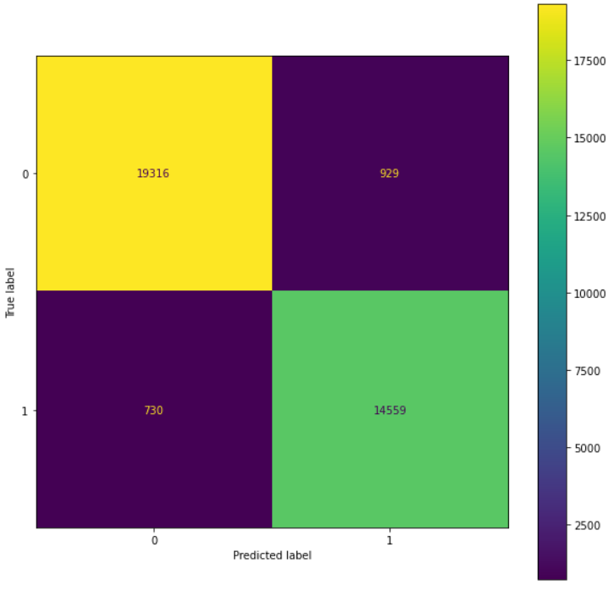
Project analysis slide 4
Predicting label:LOC_home
Accuracy – 95%
Confusion Matrix
Precision – 95%
Recall – 95%
F1 Score – 95%

Slide 7
Prediction results on multiple labels
Labels:
label:LOC_home
label:LYING_DOWN
label:SITTING
label:OR_indoors
label:PHONE_ON_TABLE
Label:SLEEPING
Result:
Accuracy – 84.88%
Precision – 97.37%
Recall – 96.91%
F1 score – 97.14%

